Slide 1
1
FUNCTIONS AND LIMITS
.

Slide 2
1.2
A Catalog of Essential Functions
.

Slide 3
Mathematical Modeling

Slide 4
Mathematical Modeling
A mathematical model is a mathematical description (often by means of a function or an equation) of a real-world phenomenon such as the size of a population, the demand for a product, the speed of a falling object.
The purpose of the model is to understand the phenomenon and perhaps to make predictions about future behavior.

Slide 5
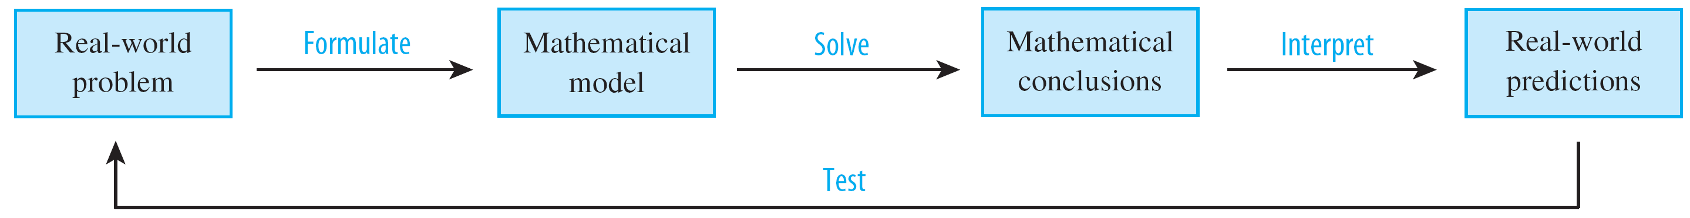
Mathematical Modeling
Figure 1 illustrates the process of mathematical modeling.
Given a real-world problem, our first task is to formulate a mathematical model by identifying and naming the independent and dependent variables and making assumptions that simplify the phenomenon enough to make it mathematically tractable.
The modeling process
Figure1

Slide 6
Mathematical Modeling
The second stage is to apply the mathematics that we know to the mathematical model that we have formulated in order to derive mathematical conclusions.
Then, in the third stage, we take those mathematical conclusions and interpret them as information about the original real-world phenomenon by way of offering explanations or making predictions.
The final step is to test our predictions by checking against new real data. If the predictions don’t compare well with reality, we need to refine our model or to formulate a new model and start the cycle again.

Slide 7

Mathematical Modeling
A mathematical model is never a completely accurate representation of a physical situation—it is an idealization.
Linear Models
When we say that y is a linear function of x, we mean that the graph of the function is a line, so we can use the slope-intercept form of the equation of a line to write a formula for the function as
where m is the slope of the line and b is the y-intercept. A characteristic feature of linear functions is that they grow at a constant rate.

Slide 8

Example 1
(a) As dry air moves upward, it expands and cools. If the ground temperature is 20°C and the temperature at a height of 1 km is 10°C, express the temperature T (in °C) as a function of the height h (in kilometers), assuming that a linear model is appropriate.
(b) Draw the graph of the function in part (a). What does the slope represent?
(c) What is the temperature at a height of 2.5 km?
Solution:
(a) Because we are assuming that T is a linear function of h, we can write

Slide 9



Example 1 – Solution
cont’d
We are given that T = 20 when h = 0, so
In other words, the y-intercept is b = 20.
We are also given that T = 10 when h = 1, so
The slope of the line is therefore m = 10 – 20 = –10 and the required linear function is

Slide 10
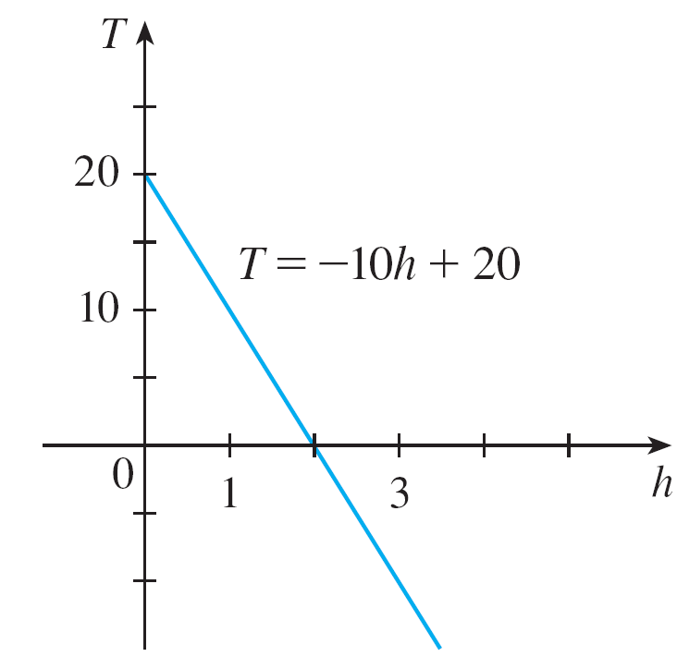
Example 1 – Solution
cont’d
(b) The graph is sketched in Figure 3.
The slope is m = –10°C/km, and this represents the rate of change of temperature with respect to height.
Figure 3

Slide 11
Example 1 – Solution
cont’d
(c) At a height of h = 2.5 km, the temperature is

Slide 12

Mathematical Modeling
Polynomials
A function P is called a polynomial if
where n is a nonnegative integer and the numbers a₀, a₁, a₂, . . . , a_{n} are constants called the coefficients of the polynomial.
The domain of any polynomial is If the leading coefficient a_{n} ≠ 0, then the degree of the polynomial is n.

Slide 13


Mathematical Modeling
A polynomial of degree 1 is of the form and so it is a linear function. A polynomial of degree 2 is of the form and is called a quadratic function.
A polynomial of degree 3 is of the form
and is called a cubic function.

Slide 14
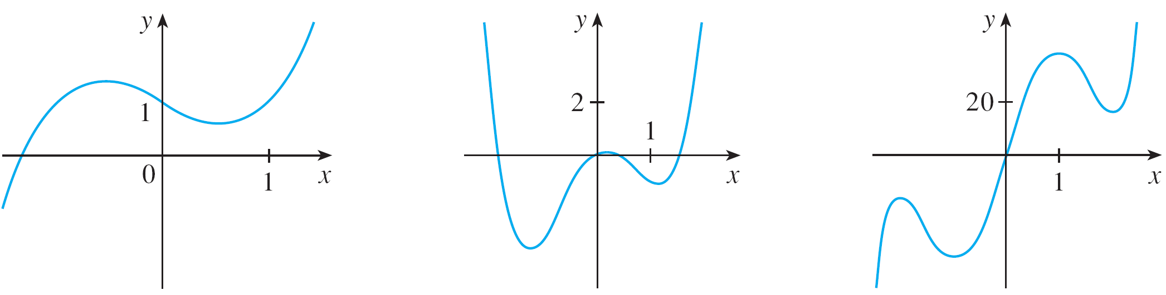
Mathematical Modeling
Figure 5 shows the graph of a cubic function in part (a) and graphs of polynomials of degrees 4 and 5 in parts (b) and (c).
(a) y = x³ – x + 1
(b) y = x⁴ – 3x² + x
(c) y = 3x⁵ – 25x³ + 60x
Figure 5

Slide 15

Mathematical Modeling
Power Functions
A function of the form , where a is a constant, is called a power function. We consider several cases.

Slide 16

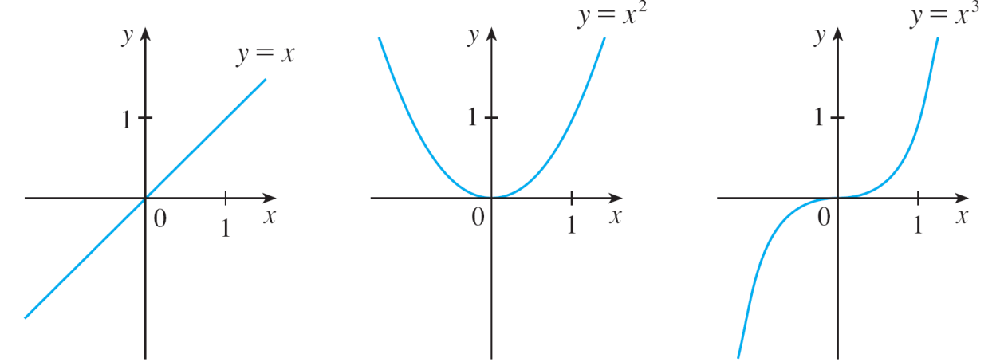
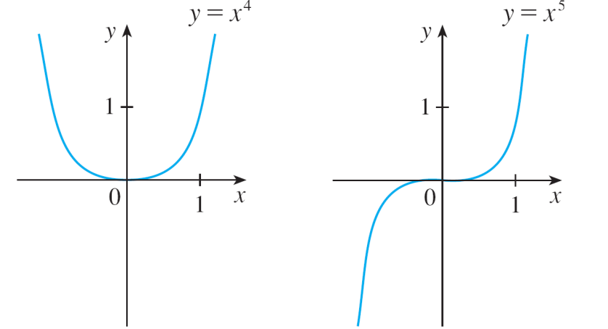
Mathematical Modeling
(i) a = n, where n is a positive integer
The graphs of for n = 1, 2, 3, 4, and 5 are shown in Figure 6.
Graphs of f(x) = x^{n} for n = 1, 2, 3, 4, 5
Figure 6

Slide 17


Mathematical Modeling
The general shape of the graph of depends on whether n is even or odd. If n is even, then is an even function and its graph is similar to the parabola
If n is odd, then is an odd function and its graph is similar to that of

Slide 18






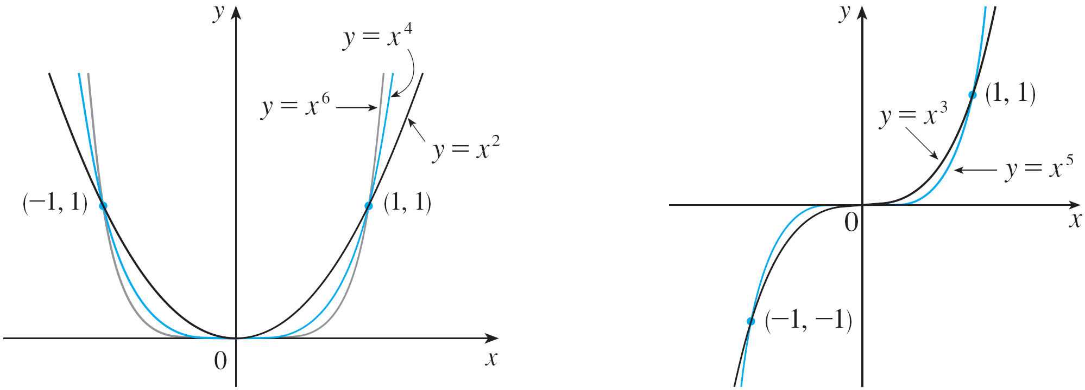
Mathematical Modeling
Notice from Figure 7, however, that as n increases, the graph of becomes flatter near 0 and steeper when (If is small, then is smaller, is even smaller, is smaller still, and so on.)
Families of power functions
Figure 7

Slide 19




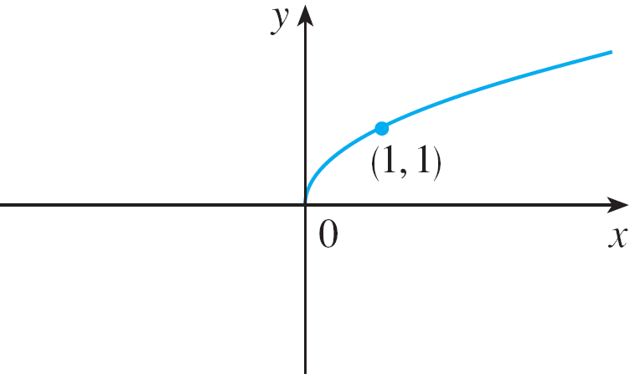

Mathematical Modeling
(ii) a = 1/n, where n is a positive integer
The function is a root function. For n = 2 it is the square root function whose domain is and whose graph is the upper half of the parabola
[See Figure 8(a).]
Graph of root function
Figure 8(a)

Slide 20




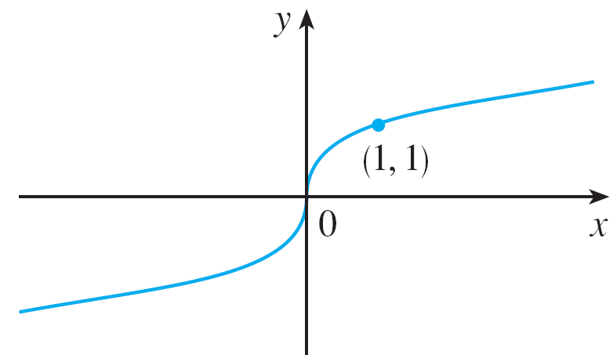




Mathematical Modeling
For other even values of n, the graph of is similar to that of For n = 3 we have the cube root function whose domain is and whose graph is shown in Figure 8(b).
The graph of for n odd is similar to that of
Graph of root function
Figure 8(b)

Slide 21

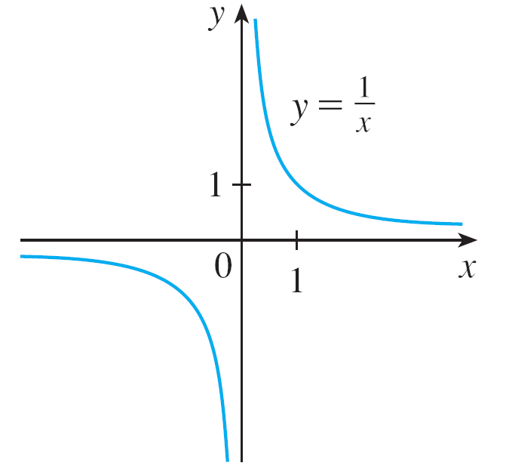
Mathematical Modeling
(iii) a = –1
The graph of the reciprocal function is shown in Figure 9.
The reciprocal function
Figure 9

Slide 22


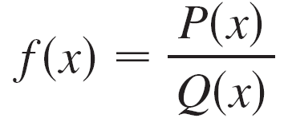

Mathematical Modeling
Its graph has the equation or , and is a hyperbola with the coordinate axes as its asymptotes.
Rational Functions
A rational function f is a ratio of two polynomials:
where P and Q are polynomials. The domain consists of all values of x such that

Slide 23
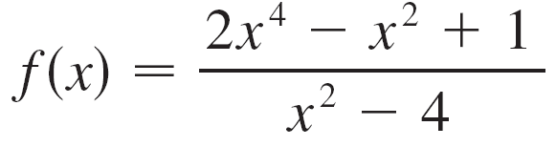

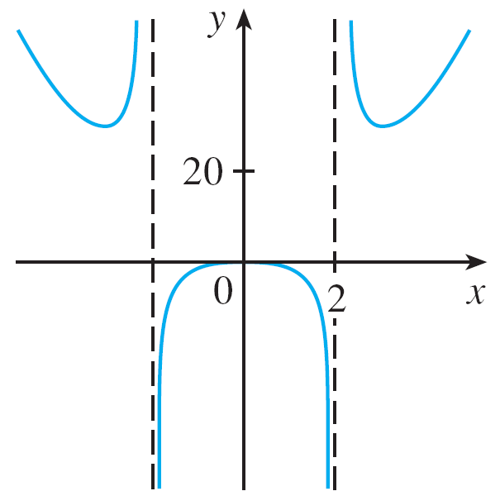
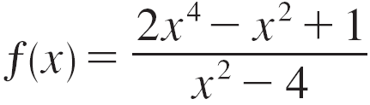
Mathematical Modeling
The function
is a rational function with domain Its graph is shown in Figure 10.
Figure 10

Slide 24
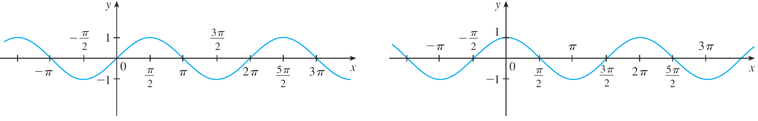


Mathematical Modeling
Trigonometric Functions
The graphs of the sine and cosine functions are as shown in Figure 11.
(a)
(b)
Figure 11

Slide 25



Mathematical Modeling
Notice that for both the sine and cosine functions the domain is and the range is the closed interval
[–1, 1]. Thus, for all values of x, we have
or, in terms of absolute values,

Slide 26

Mathematical Modeling
Also, the zeros of the sine function occur at the integer multiples of π ; that is,
An important property of the sine and cosine functions is that they are periodic functions and have period 2π. This means that, for all values of x,

Slide 27
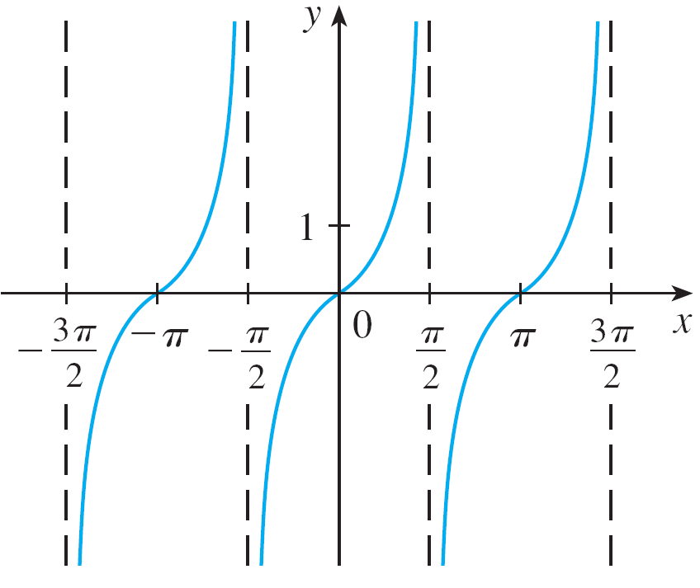
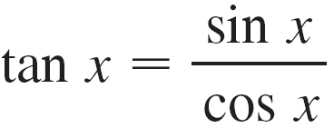

Mathematical Modeling
The periodic nature of these functions makes them suitable for modeling repetitive phenomena such as tides, vibrating springs, and sound waves.
The tangent function is related to the sine and cosine functions by the equation
and its graph is shown in Figure 12.
Figure 12

Slide 28


Mathematical Modeling
It is undefined whenever cos x = 0, that is, when
Its range is Notice that the tangent function has period π :
Exponential Functions and Logarithms
The exponential functions are the functions of the form where the base a is a positive constant.

Slide 29


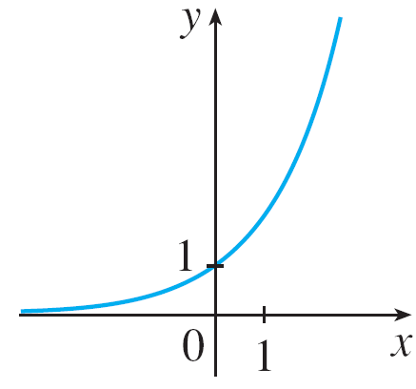
Mathematical Modeling
The graph of y = 2^{x} is shown in Figure 13, the domain is
and the range is
y = 2^{x}
Figure 13

Slide 30

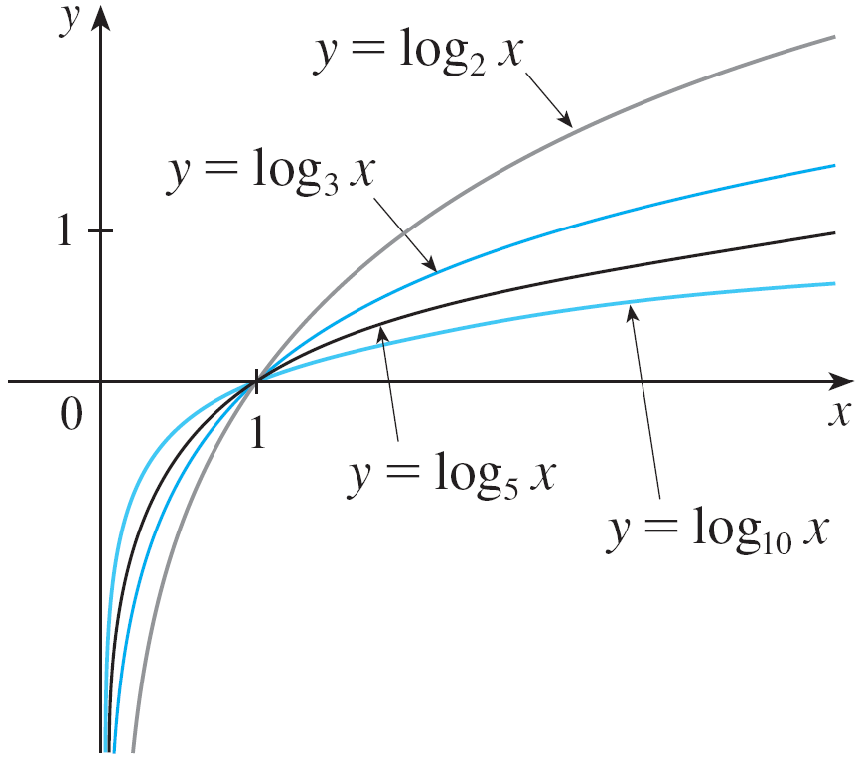


Mathematical Modeling
The logarithmic functions where the base a is a positive constant, are the inverse functions of the exponential functions.
Figure 14 shows the graphs of four logarithmic functions with various bases. In each case the domain is the range is and the function increases slowly when x >1.
Figure 14

Slide 31
Transformations of Functions

Slide 32
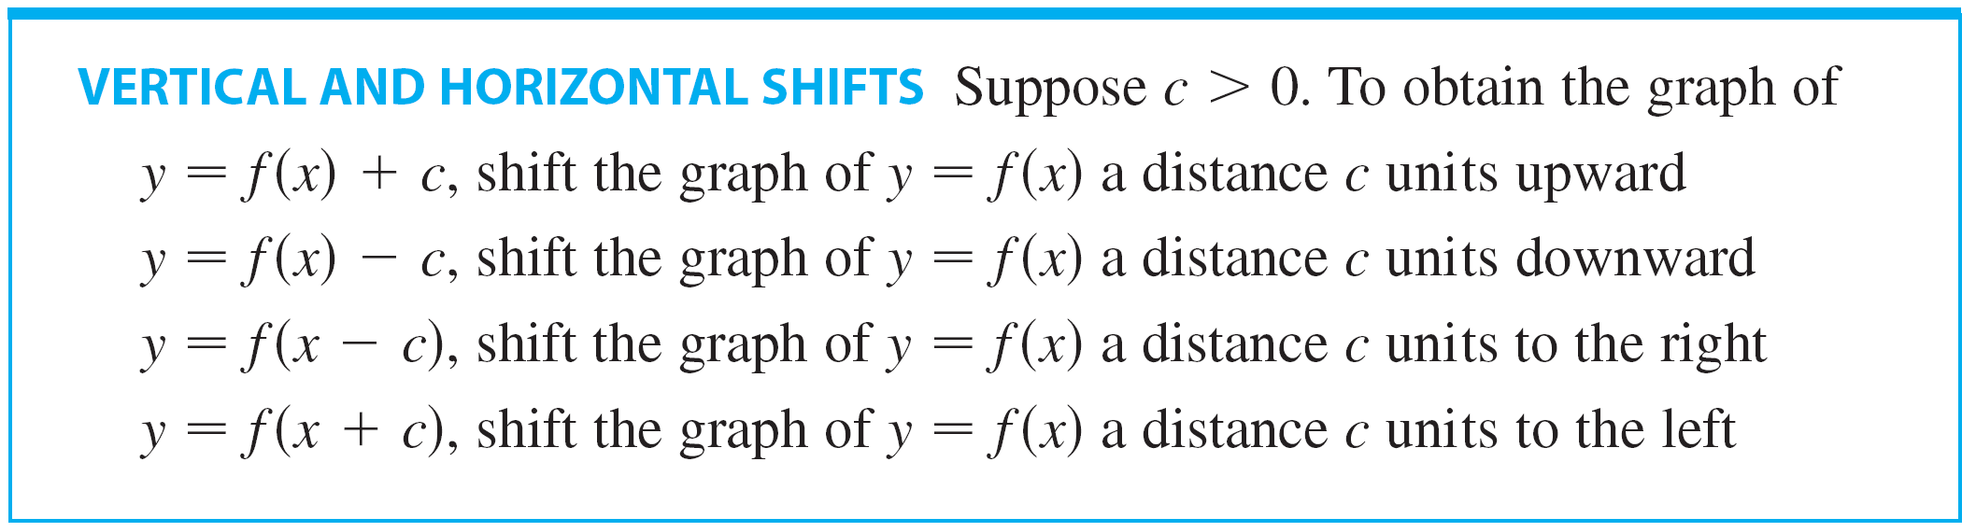
Transformations of Functions
By applying certain transformations to the graph of a given function we can obtain the graphs of certain related functions.
Let’s first consider translations. The following chart incorporates the results of Vertical and Horizontal shift.

Slide 33
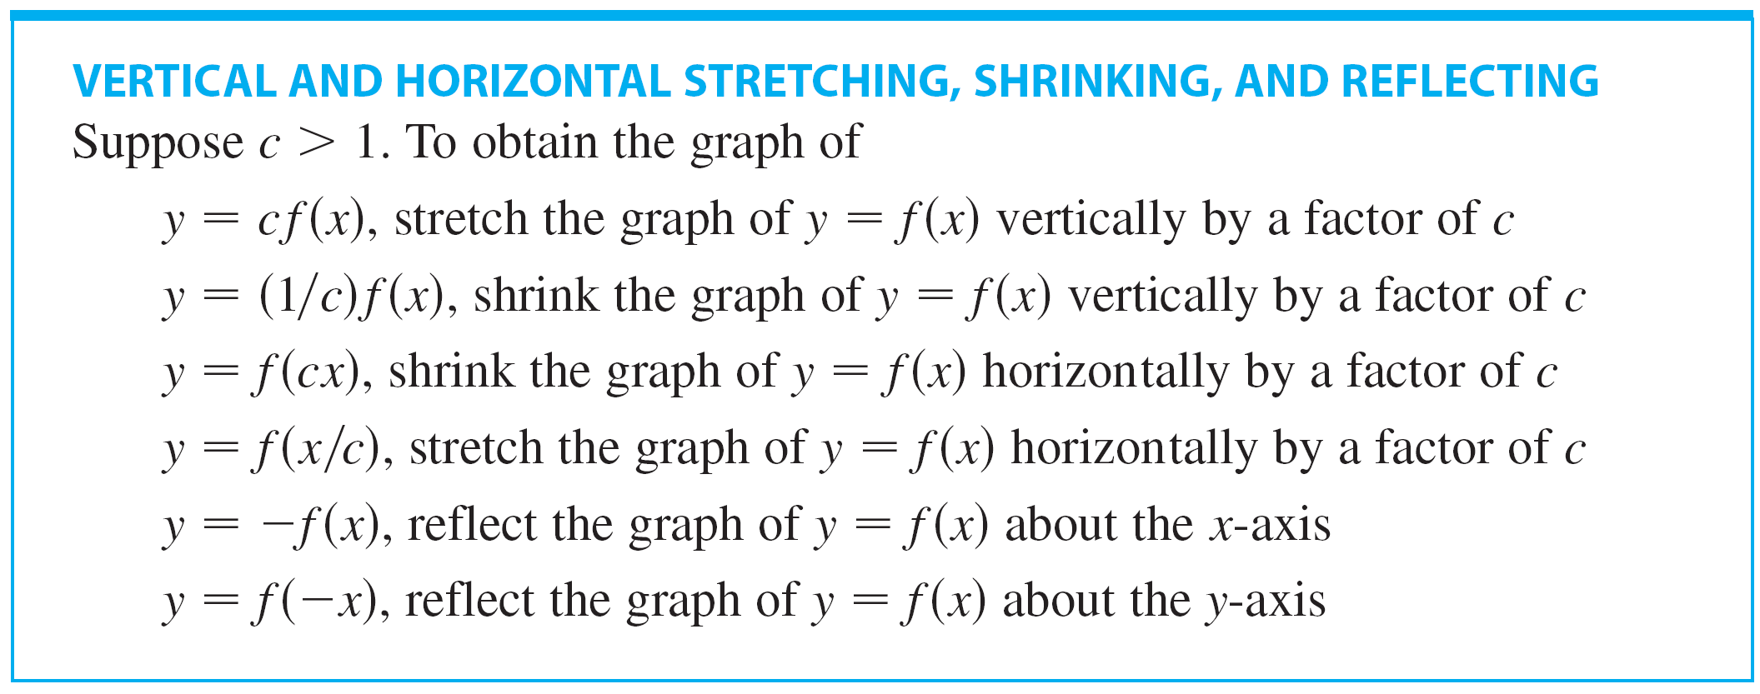
Transformations of Functions
Now let’s consider the stretching and reflecting transformations.
The following chart incorporates the results of other stretching, shrinking, and reflecting transformations.

Slide 34

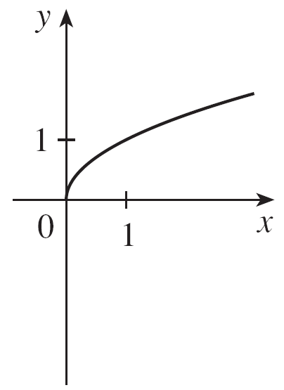


Example 2
Given the graph of use transformations to graph
Solution:
The graph of the square
root function is
shown in Figure 17(a).
Figure 17(a)

Slide 35





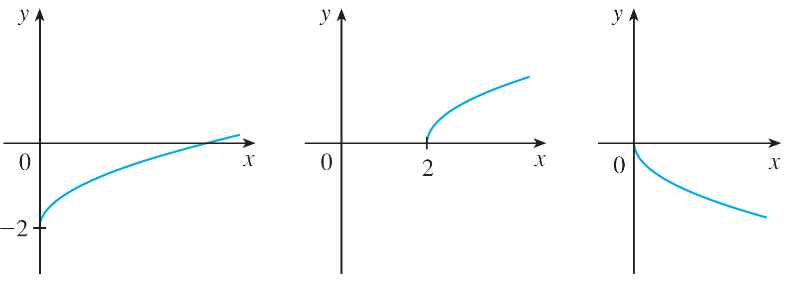
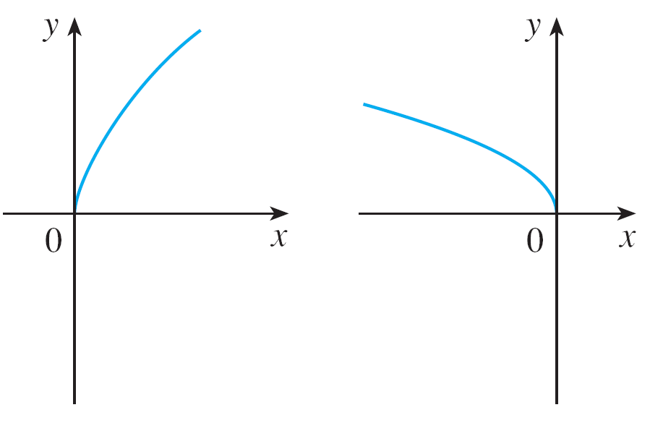





Example 2 – Solution
cont’d
In the other parts of the figure we sketch by shifting 2 units downward, by shifting 2 units to the right, by reflecting about the x-axis, by stretching vertically by a factor of 2, and by reflecting about the y-axis.
(b)
(c)
(d)
(e)
(f)
Figure 17

Slide 36
Example 3
Sketch the graph of the function
Solution:
To obtain the graph of y = 1 – sin x , we again start with
y = sin x. We reflect about the x-axis to get the graph of
y = – sin x. Then, we shift 1 unit upward to get y = 1 – sin x.

Slide 37
Combinations of Functions

Slide 38
Combinations of Functions
Two functions f and g can be combined to form new functions f + g, f – g, fg, and f/g in a manner similar to the way we add, subtract, multiply, and divide real numbers. The sum and difference functions are defined by
If the domain of f is A and the domain of g is B, then the domain of f + g is the intersection A ∩ B because both f (x) and g(x) have to be defined.

Slide 39
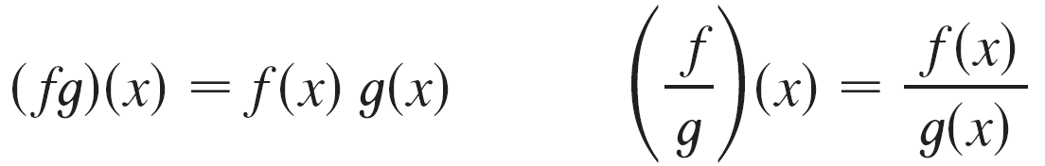

Combinations of Functions
Similarly, the product and quotient functions are defined by
The domain of fg is A ∩ B, but we can’t divide by 0 and so the domain of f/g is
In general, given any two functions f and g, we start with a number x in the domain of g and find its image g(x). If this number g(x) is in the domain of f, then we can calculate the value of f(g(x)).

Slide 40
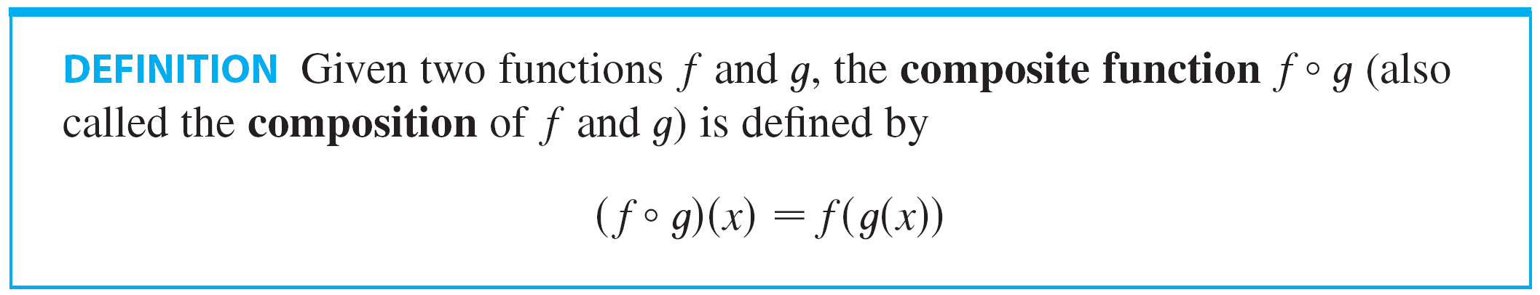
Combinations of Functions
The result is a new function h(x) = f(g(x)) obtained by substituting g into f. It is called the composition (or composite) of f and g and is denoted by f ° g (“f circle g”).
The domain of f ° g is the set of all x in the domain of g such that g(x) is in the domain of f. In other words, (f ° g)(x) is defined whenever both g (x ) and f (g(x ) ) are defined.

Slide 41
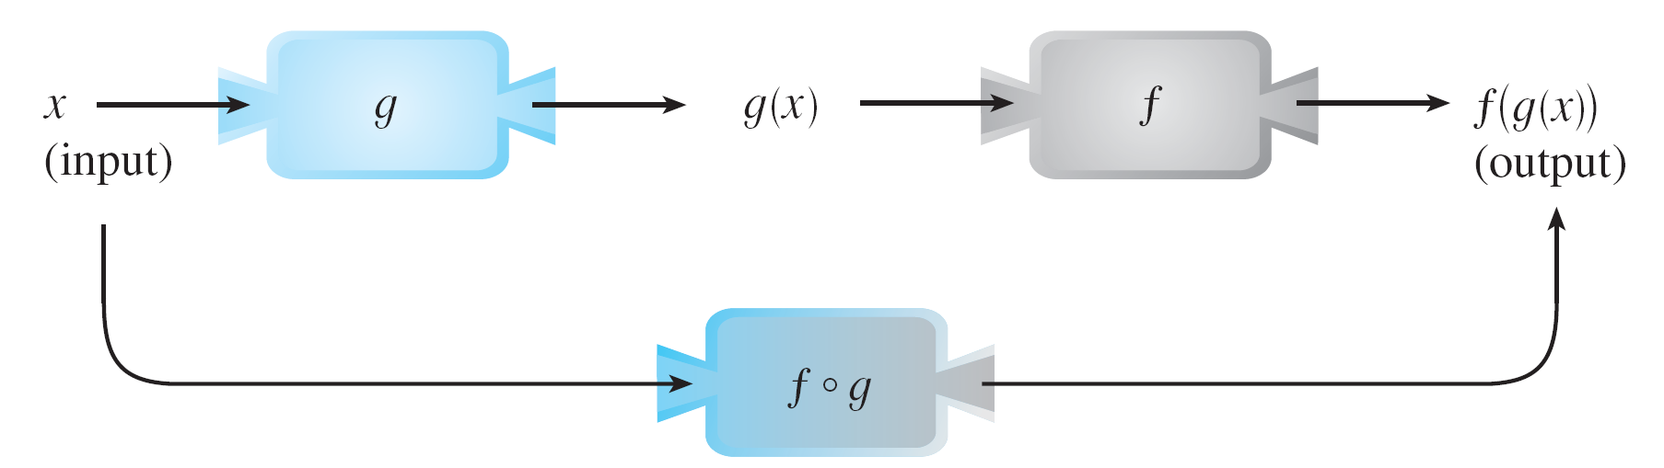
Combinations of Functions
Figure 19 shows how to picture f ° g in terms of machines.
The f ° g machine is composed of the g machine (first) and then the f machine.
Figure 19

Slide 42
Example 4
If f(x) = x² and g(x) = x – 3, find the composite functions and .
SOLUTION
We have

Slide 43


Example 5
If and find each function and its domain.
(a) f ° g (b) g ° f (c) f ° f (d) g ° g
Solution:
(a)

Slide 44


Example 5 – Solution
cont’d
The domain of f ° g is
(b)
For to be defined we must have

Slide 45






Example 5 – Solution
cont’d
For to be defined we must have that is, or
Thus we have so the domain of g ° f is the closed interval [0, 4].
(c)
The domain of f ° f is

Slide 46







Example 5 – Solution
cont’d
(d)
This expression is defined when both and
The first inequality means and the second is equivalent to or or
Thus, so the domain of g ° g is the closed interval [ –2, 2].

Slide 47
Combinations of Functions
It is possible to take the composition of three or more functions. For instance, the composite function f ° g ° h is found by first applying h, then g, and then f as follows:
(f ° g ° h )(x ) = f (g (h (x ) ) )

Slide 48
Example 6
Given , find functions f, g, and h
such that .
Solution:
Since F(x) = [cos(x + 9)]², the formula for F states: First add 9, then take the cosine of the result, and finally square.
So, we let:

Slide 49
Example 6 – Solution (Cont.)
Then,

